Slide 1
ARKANSAS HIGHWAY POLICE PERMIT SECTION

Slide 2
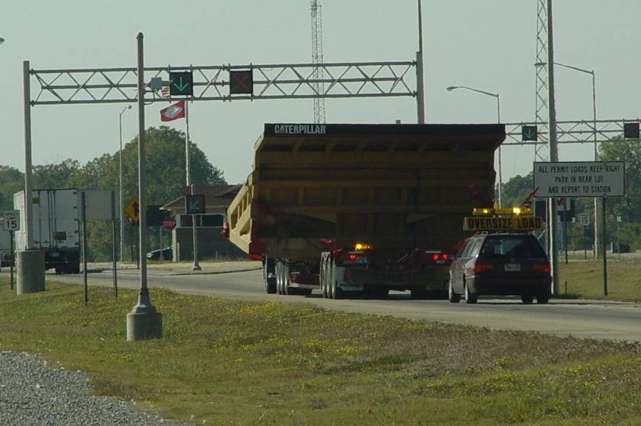
161,565 Permits for Movement Issued for FY2018
$15,730,066 Collected in Permit fees

Slide 3
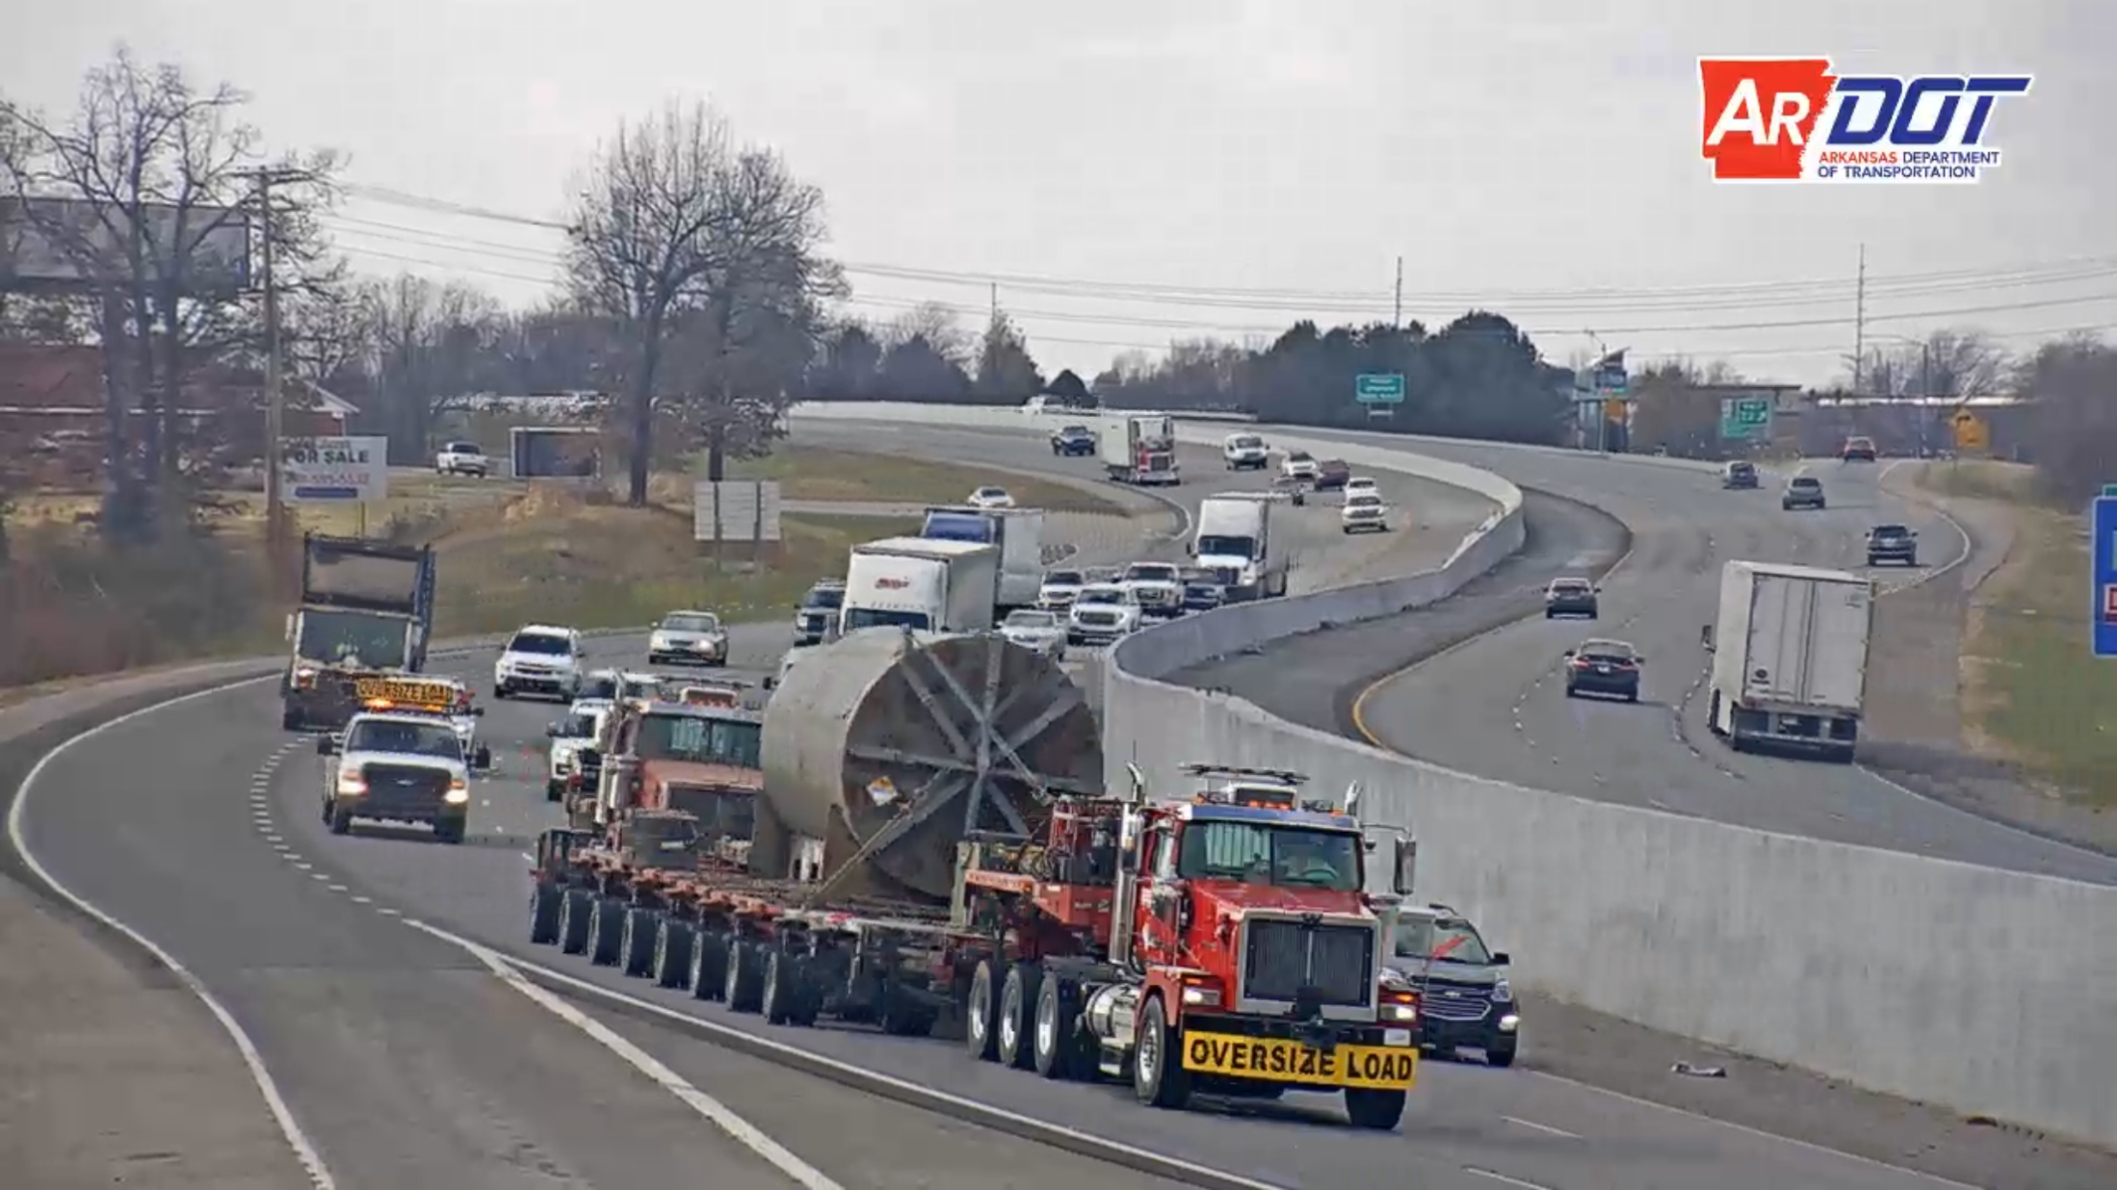
I-49 Washington Co. a reactor 504 tons (1,008,000 pounds)

Slide 4
20’ wide traveling in Northeast Arkansas

Slide 5
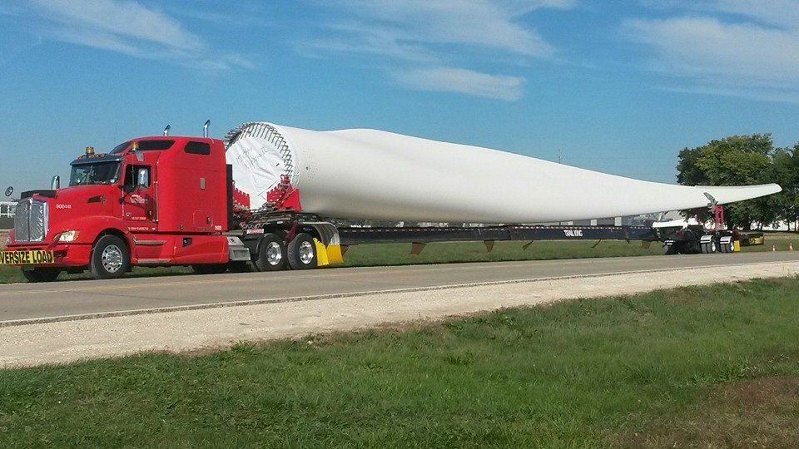
Over 200’ long and 12’ wide

Slide 6
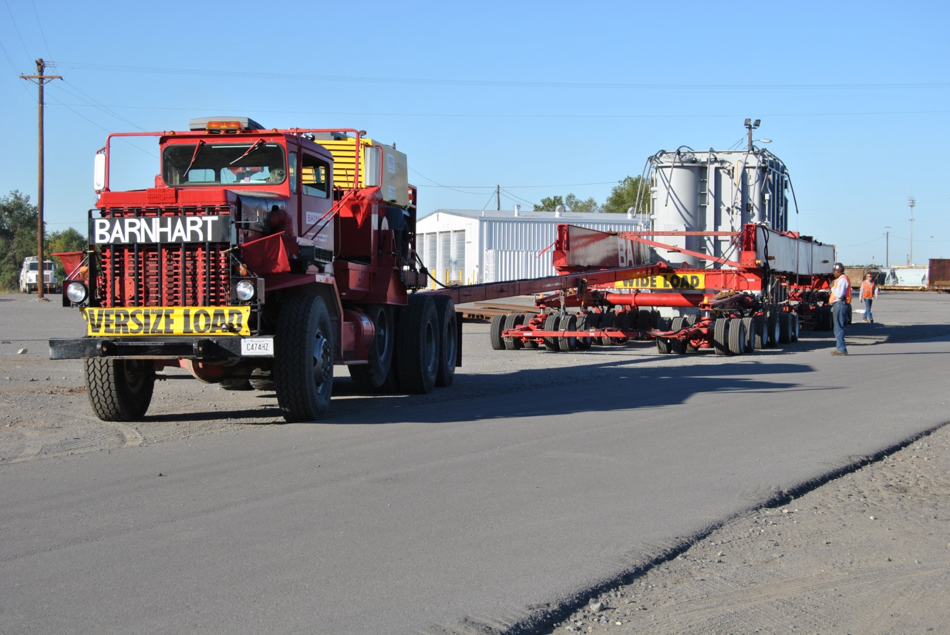
Over 18’ wide and weighed over 530,000 pounds

Slide 7
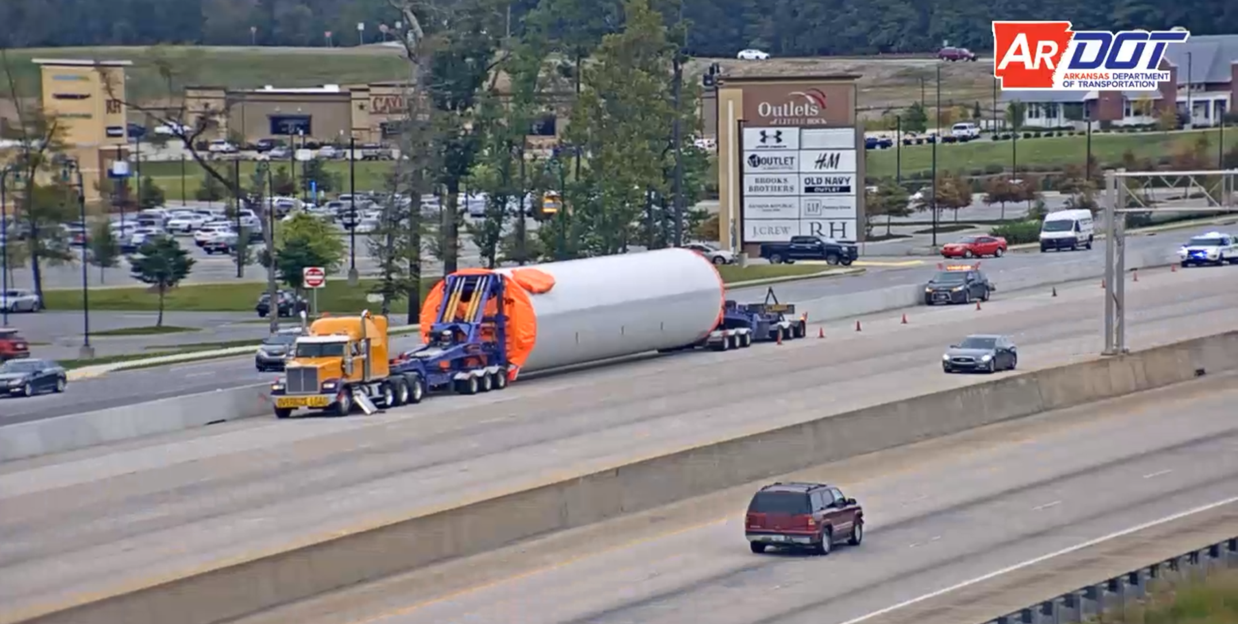
Windmill tower section 240,000 pounds, 15’2 wide,
and 135’ long

Slide 8
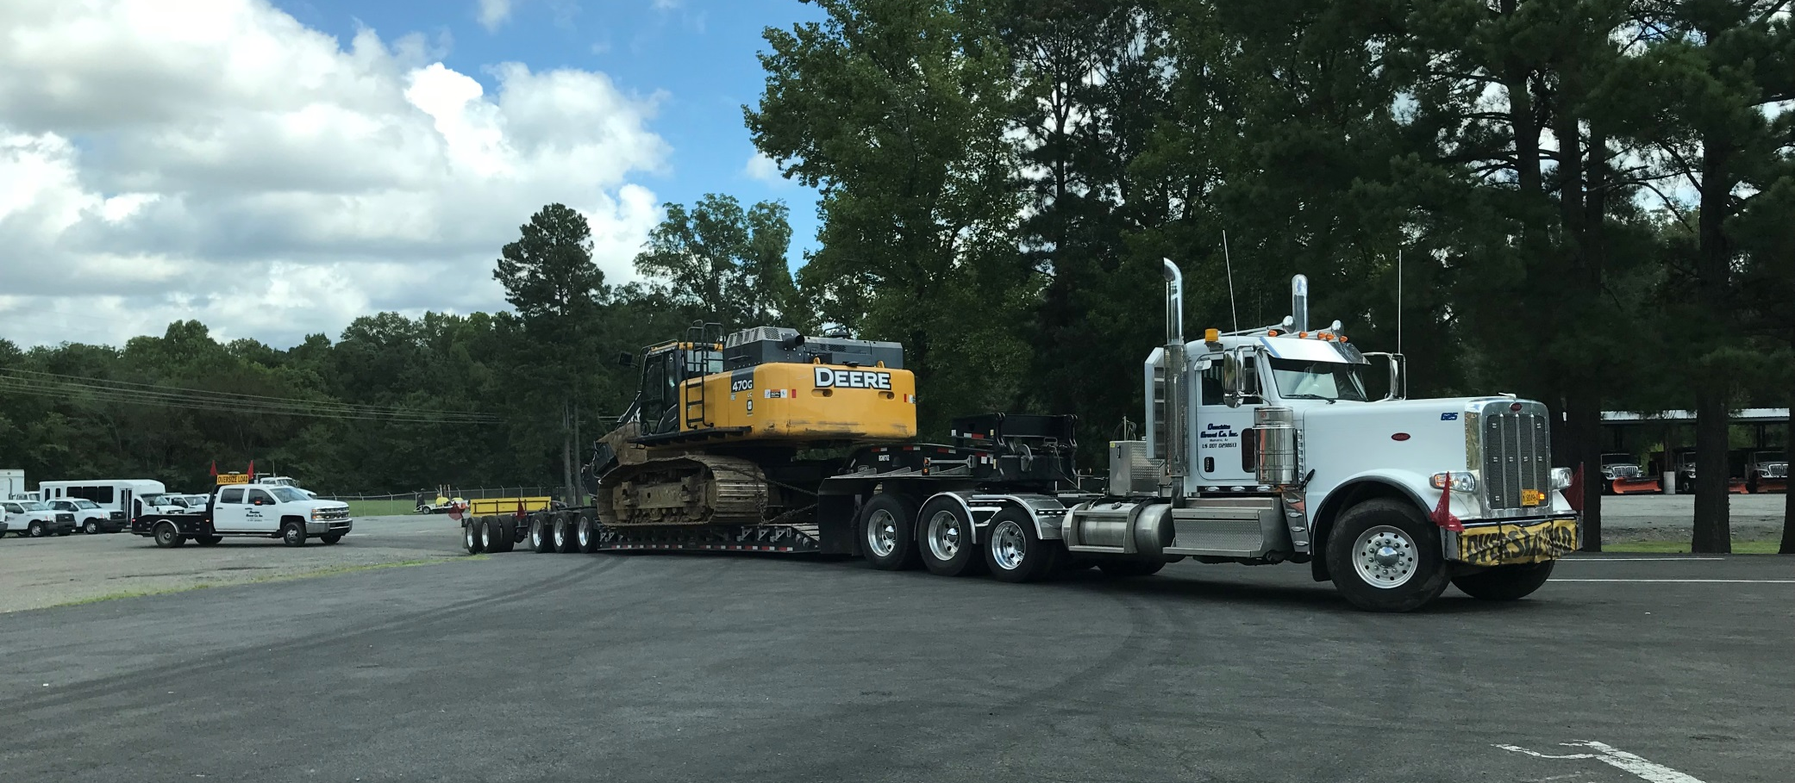
Permit for total gross weight of 180,600 pounds

Slide 9
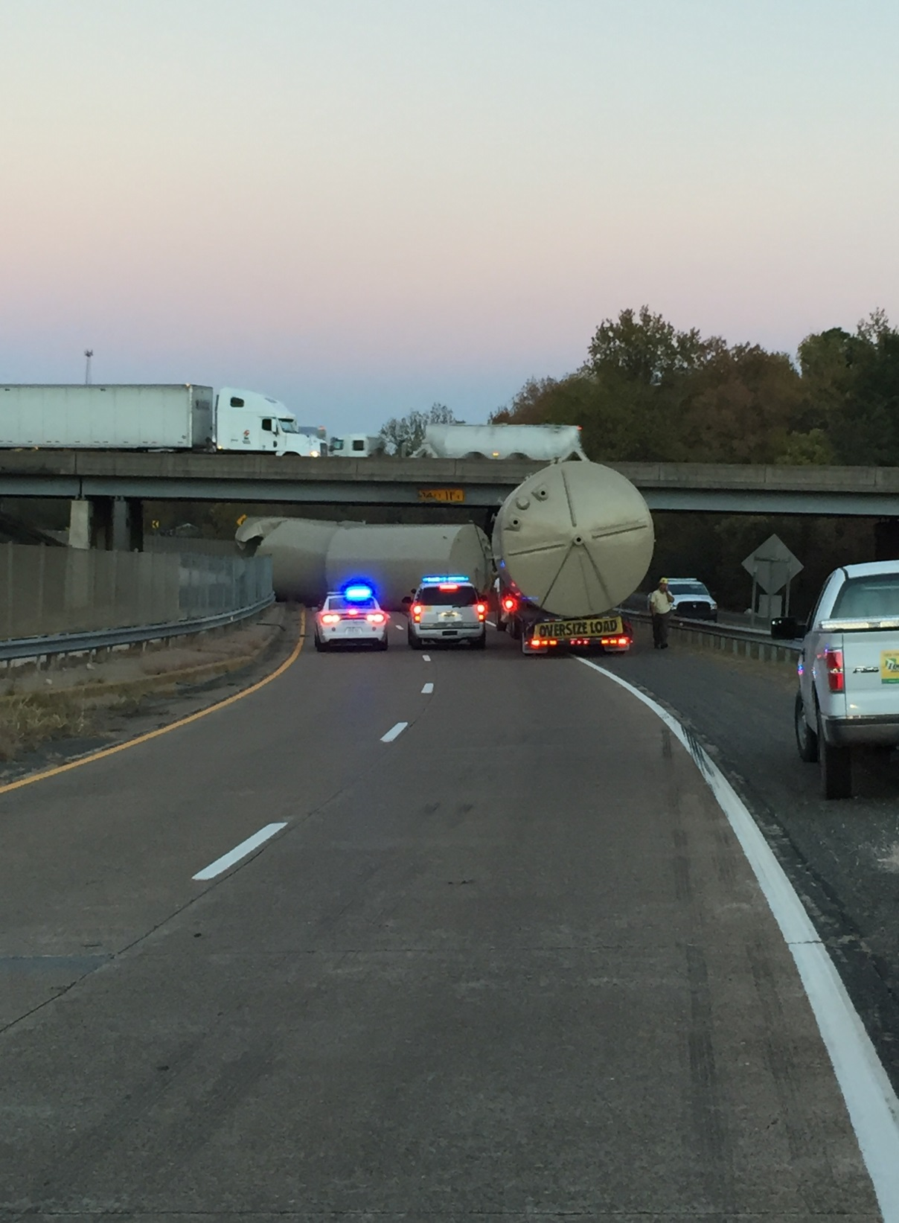
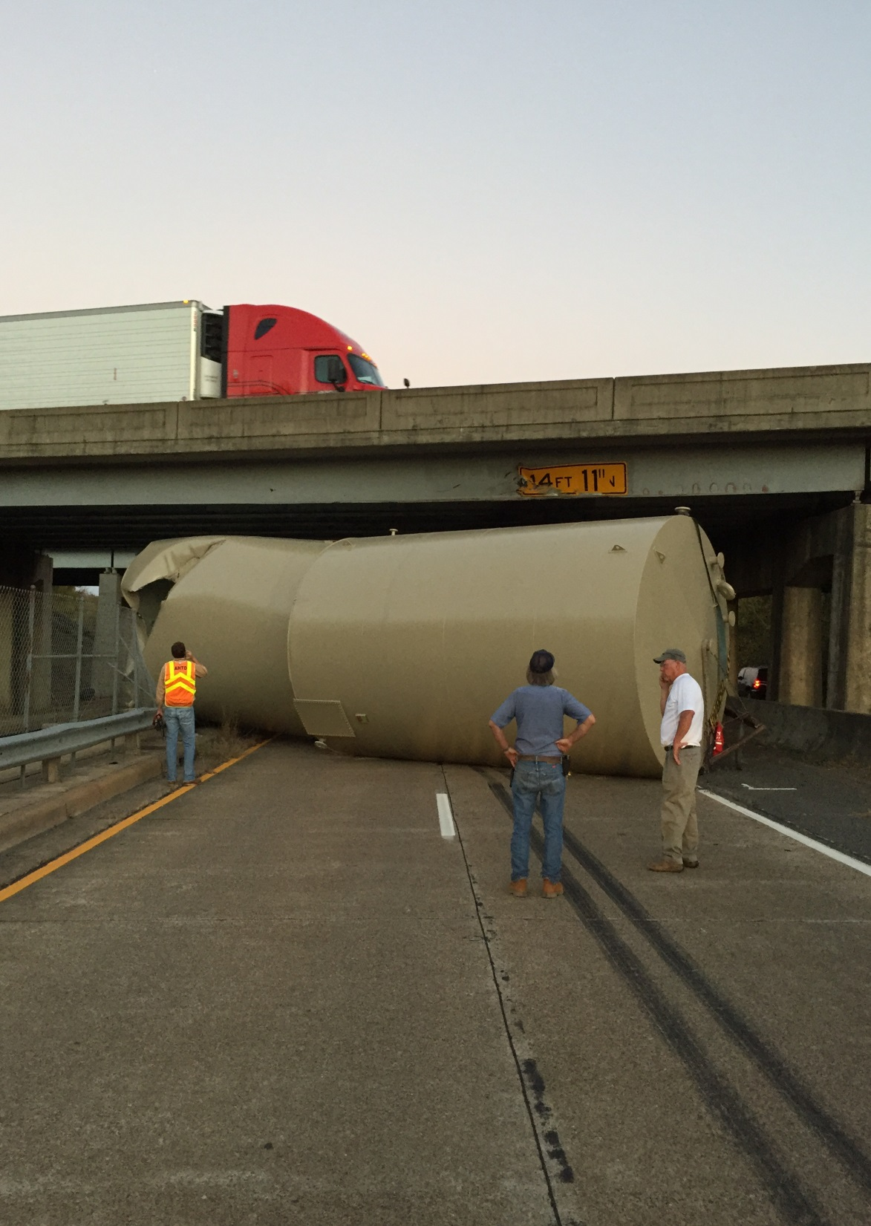
Off Route, caused $100,000 damage to the bridge

Slide 10
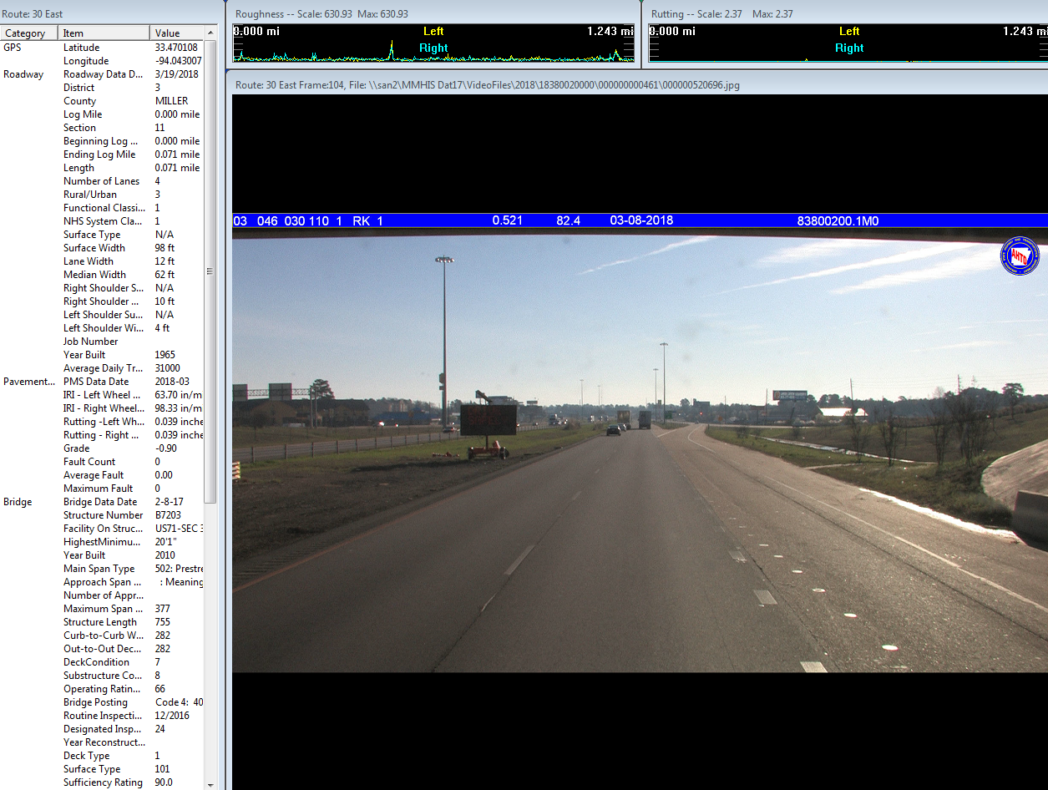
MMHIS

Slide 11
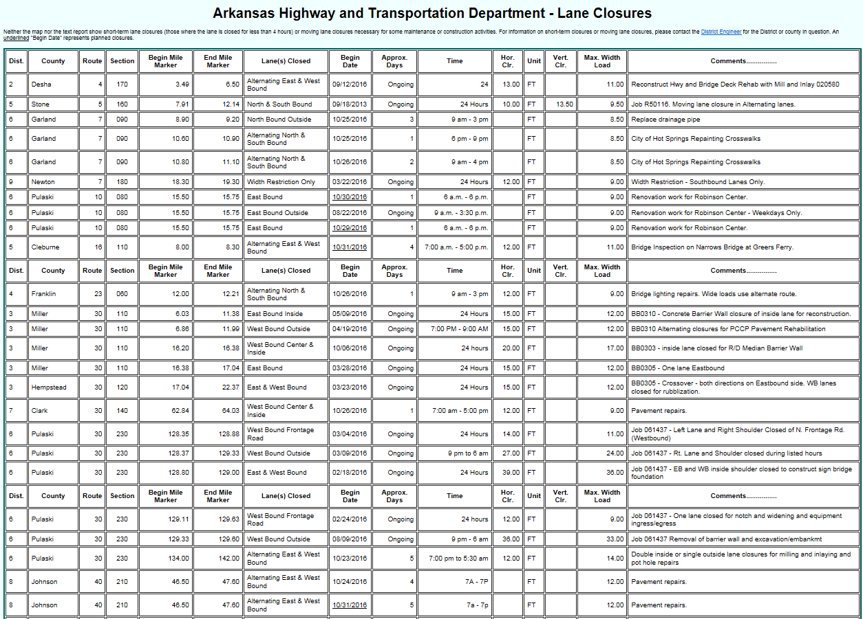
CONSTRUCTION – LANE CLOSURES

Slide 12
CONSTRUCTION – LANE CLOSURES
RESTRICTION TYPE: ROADWAY RANGE
REASON: General Information(Lane Closure Maintained Restriction)
COMMENT: JOB CA0608. NIGHTLY AND SATURDAY EB AND WB
DOUBLE LANE CLOSURES DURING OFF-PEAK HOURS.
FROM: I-630 PULASKI County Log 4.00(21)
TO: I-630 PULASKI County Log 7.00(21)
AFFECTED AREAS: EB and WB
SCHEDULED FROM 7/16/2018 UNTIL FURTHER NOTICE
AFFECTED TIMES: 8 P.M. - 6 A.M.

Slide 13
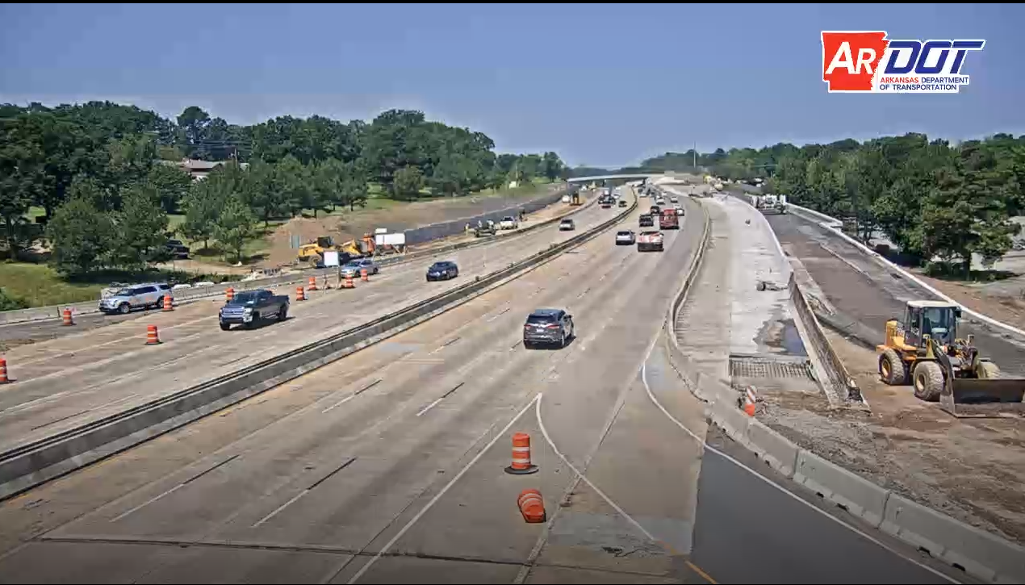
CONSTRUCTION – LANE CLOSURES

Slide 14
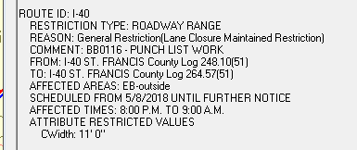

Slide 16
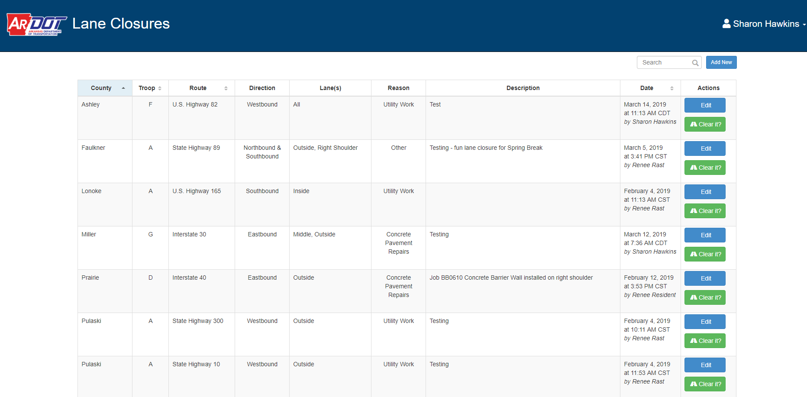

Slide 17
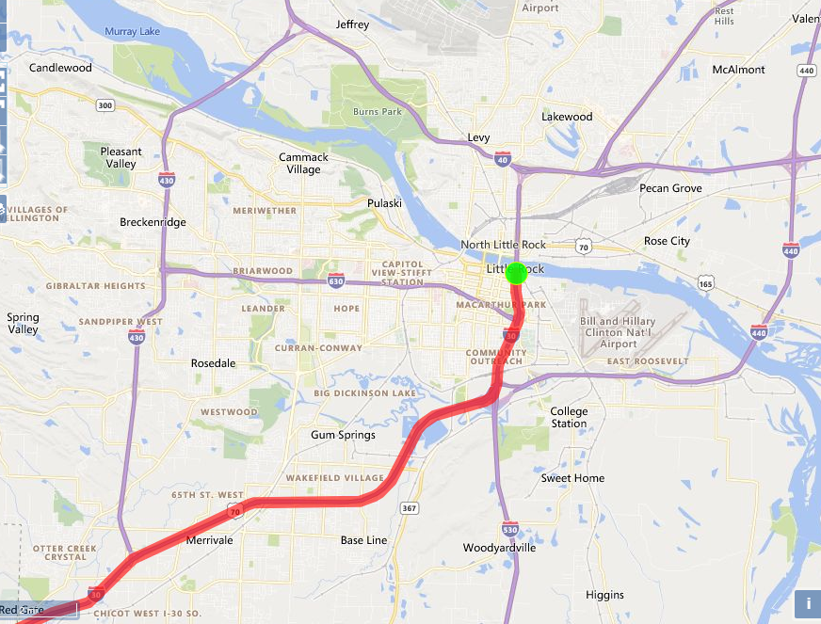
ARPARS Route Map – Going to ARNOLD

Slide 18
QUESTIONS?

